Slide 1
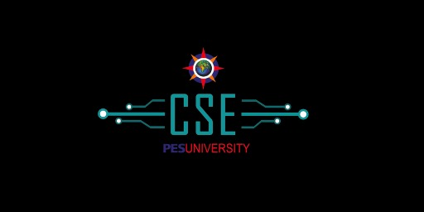

National Education Policy
WeLead
Nurture the success of every student
Embrione
KodiKon
< QUARTECH >
Akash V Angadi
Akhilesh M K
K Mohammed Asbar
Likhith V Kunder
1

Slide 2
Skill Enhancement with AR
NEP serves as a skill enhancement vocational education policy.
But the government doesn’t have enough Budget to provide all schools with required resources for the implementation (Lab Equipment's, Specimens,.. etc.).
There are about 15Lakh schools :
Government schools: 10,83,678
Government Aided schools: 84,614
Private schools: 3,25,760
Of which many of the schools are located in rural areas.
To provide these many schools with all resources is an impossible task at this moment. Hence the failure in implementation of NATIONAL EDUCATION POLICY.

Slide 3
Solution
We give contracts to professional augmented reality designers to design experimental setup based on the requirements .
These projects are accessible by schools (based on the contract between school and the team) To Teach The Students In A Virtual Mode.
Each registered school gets a password to access the contents.
School Students can learn other vocational courses and practical based course in a virtual mode.
Our project includes seperate websites for each subject which include Augmented Reality (Experiments, Classes,.. etc).
Notes:
2. Nature - Identify all the domains of technology that you would need to implement a possible solution
3. Consider pros and cons of using a particular technology

Slide 4
Here we design a set of websites. Each subject is given a website which contains Augmented Reality based learning platform. (Labs, etc..)
WHAT
HOW
The contracts are given to AR Designers to design a AR platform which are placed in the websites of the respective subjects.
WHY
The gap between the implementation of NEP and the algorithm is filled with the help of our tech to bring out the actual meaning of vocational education.

Slide 5
Technology Usage
Technology plays an important role in applying this concept as it contains the most modern concept of Augmented Reality.
This also includes the newest feature of e-payments concepts and digital learning.
Only requires a PC or a mobile phone to access the contents.
On a further scale this can also be transformed into an app
Business Prospective
The project acts as a platform which can generate revenue at place of accessibility of the AR enhanced website from institutions as well as provide jobs to AR builders.

